Slide 1
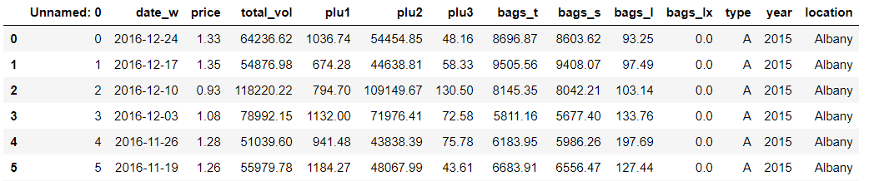
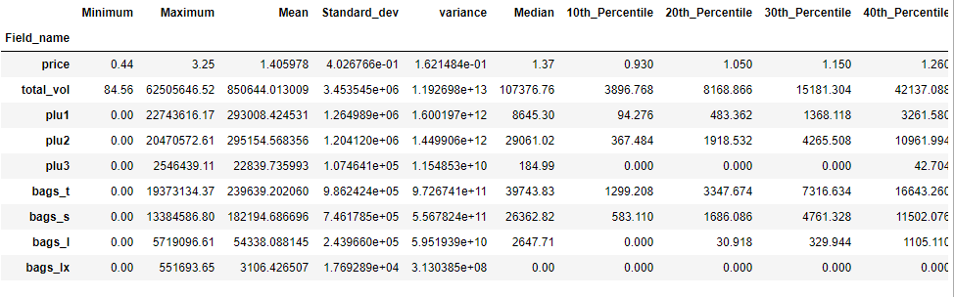
Module 2- Data Analysis
The data and its features
The Data product_a.csv consists of 14 columns with 18,249 rows
Here the Date is crucial as to check the trend of price and sales volume in a time series manner. Dates are recorded weekly basis.
Total _vol is the cast of plu1, plu2, plu3 and bags_t.
As per the summary statistics, bags_t as got a large variance as its values are widely spread out. But for other variables the values are closer to its mean values. Median and the 50th percentiles are the same and Total_val has got more the 10 modes.

Slide 2
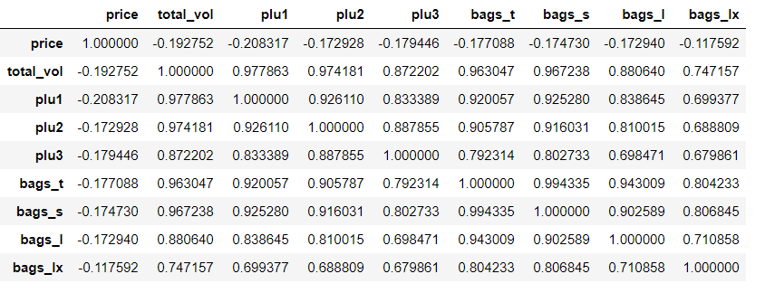
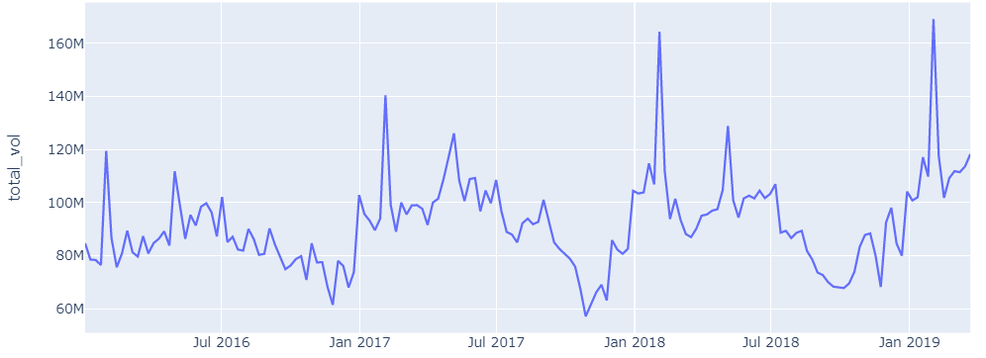
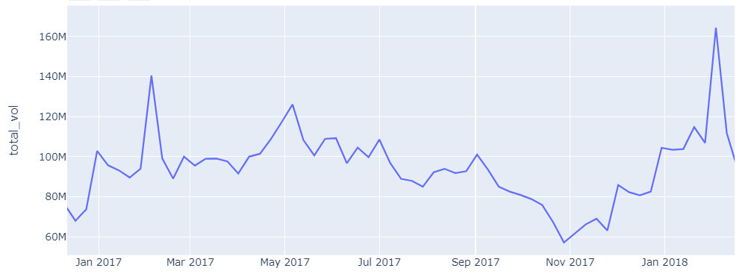
Module 2- Data Analysis
Correlation and time series of features
Plu1, plu2, plu3, bags_t, bags_s and highly positively correlated to each other. Bags_lx is positively correlated to bags_t and bags_s but the price has no affect with any other features.
Time series plot of Total_vol
Time series plot of price
Total sales volume and price has got opposite affect through out the years as price drops the volume increases. Sales volume trend in increase through out the years but dramatically dropped in 2019. Volume is high in February and low in November each year where as the price is vice versa.

Slide 3
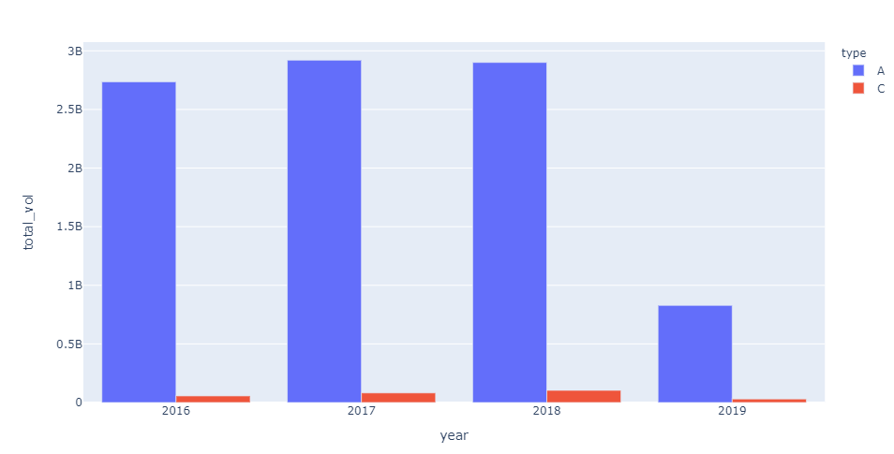
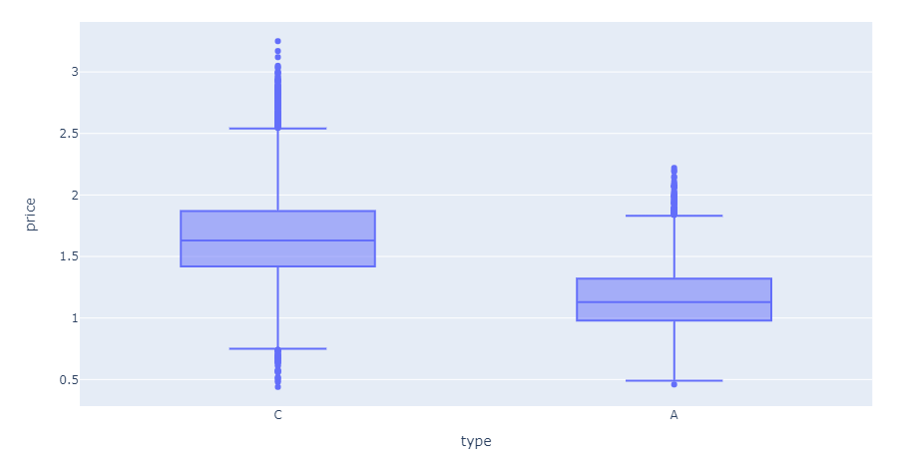
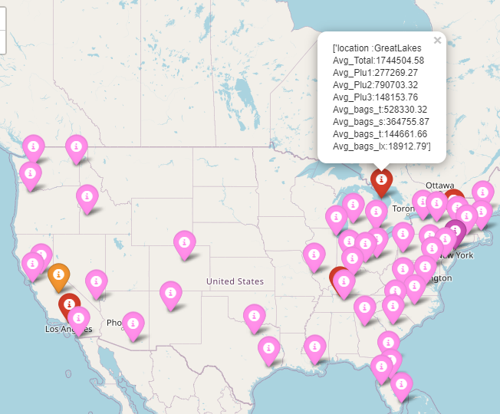
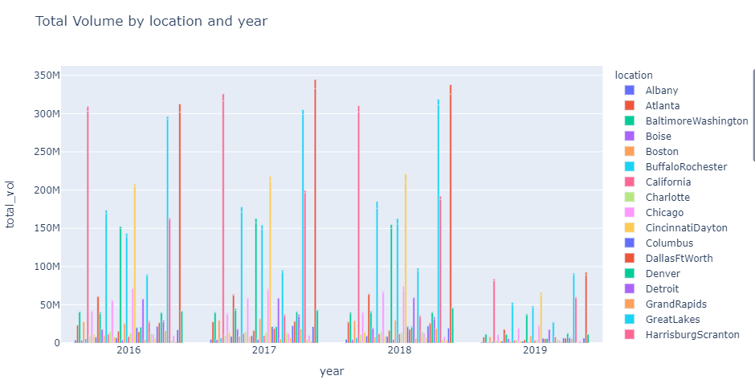
Module 2- Data Analysis
Features of price and sales per type
As you can see the price of Type A is lower than C and C has got outlies. The sales volume for type A is always high and c is very little compare to A. Both the sales drops in 2019. The sales volume per locations are given below and in map for clear view.

Slide 4
Thank You

